Slide 1
Welcome to
The AMOS Demo Day!
Dirk Riehle, FAU Erlangen
AMOS C02
Licensed under CC BY 4.0 International

Slide 2
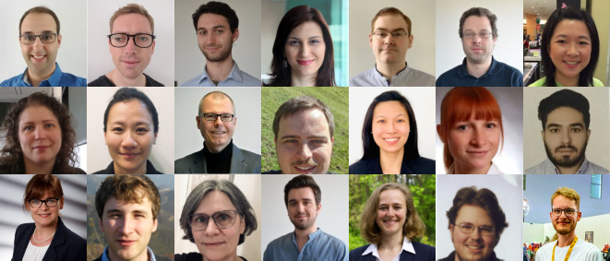
The Professorship of Open Source Software

Slide 3
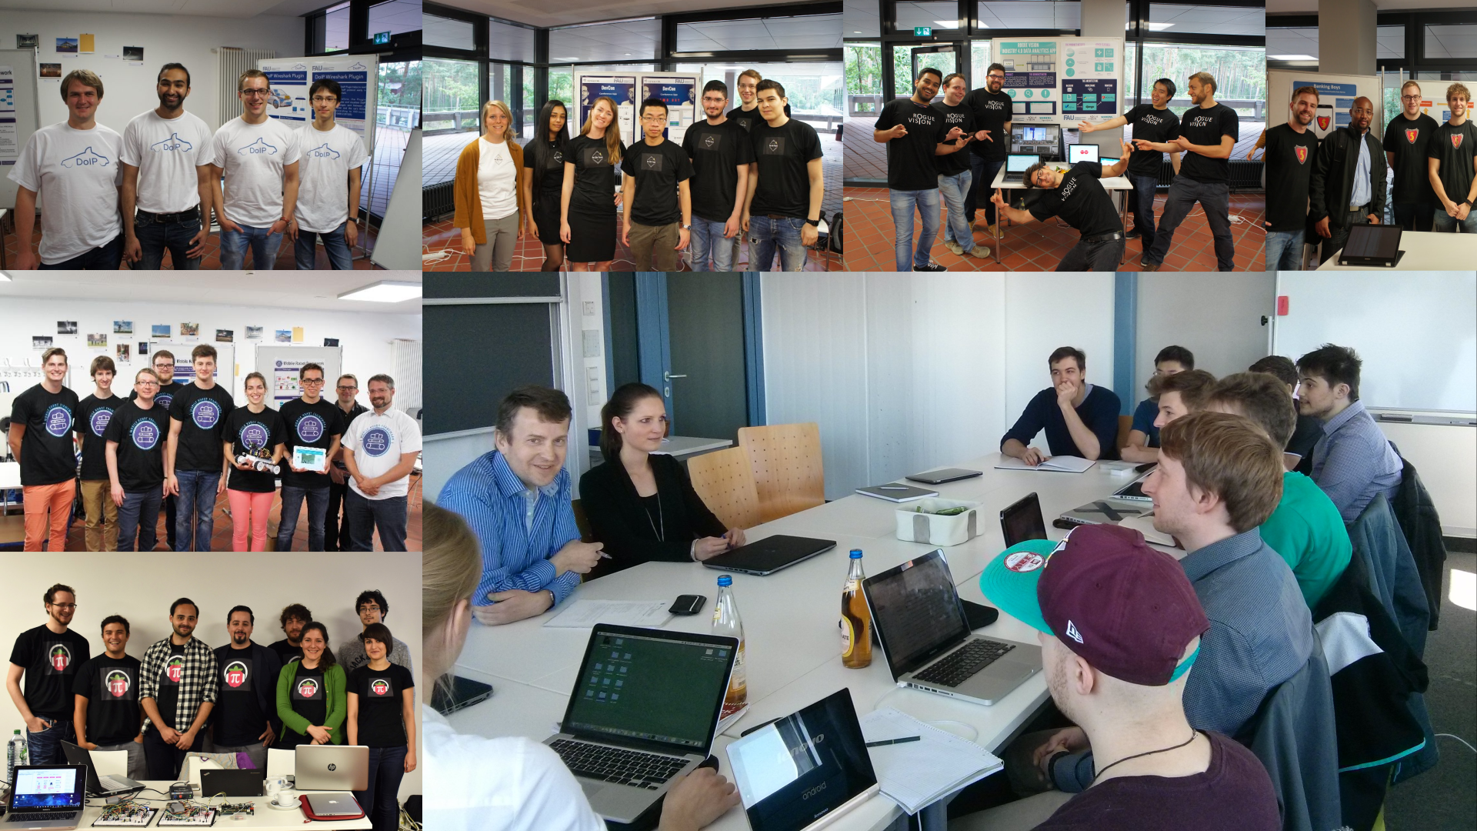

Slide 4

Industry Partners

Slide 5



Participating Universities

Slide 6
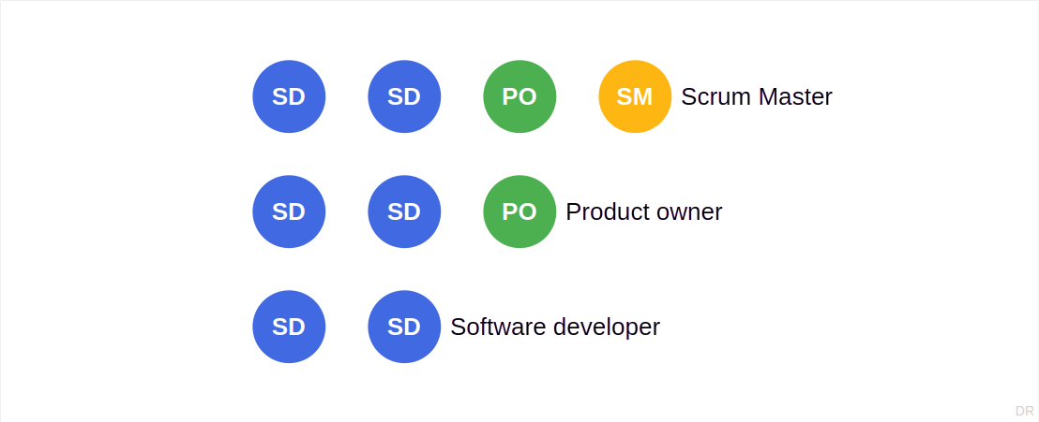
Distributed Scrum Teams

Slide 7
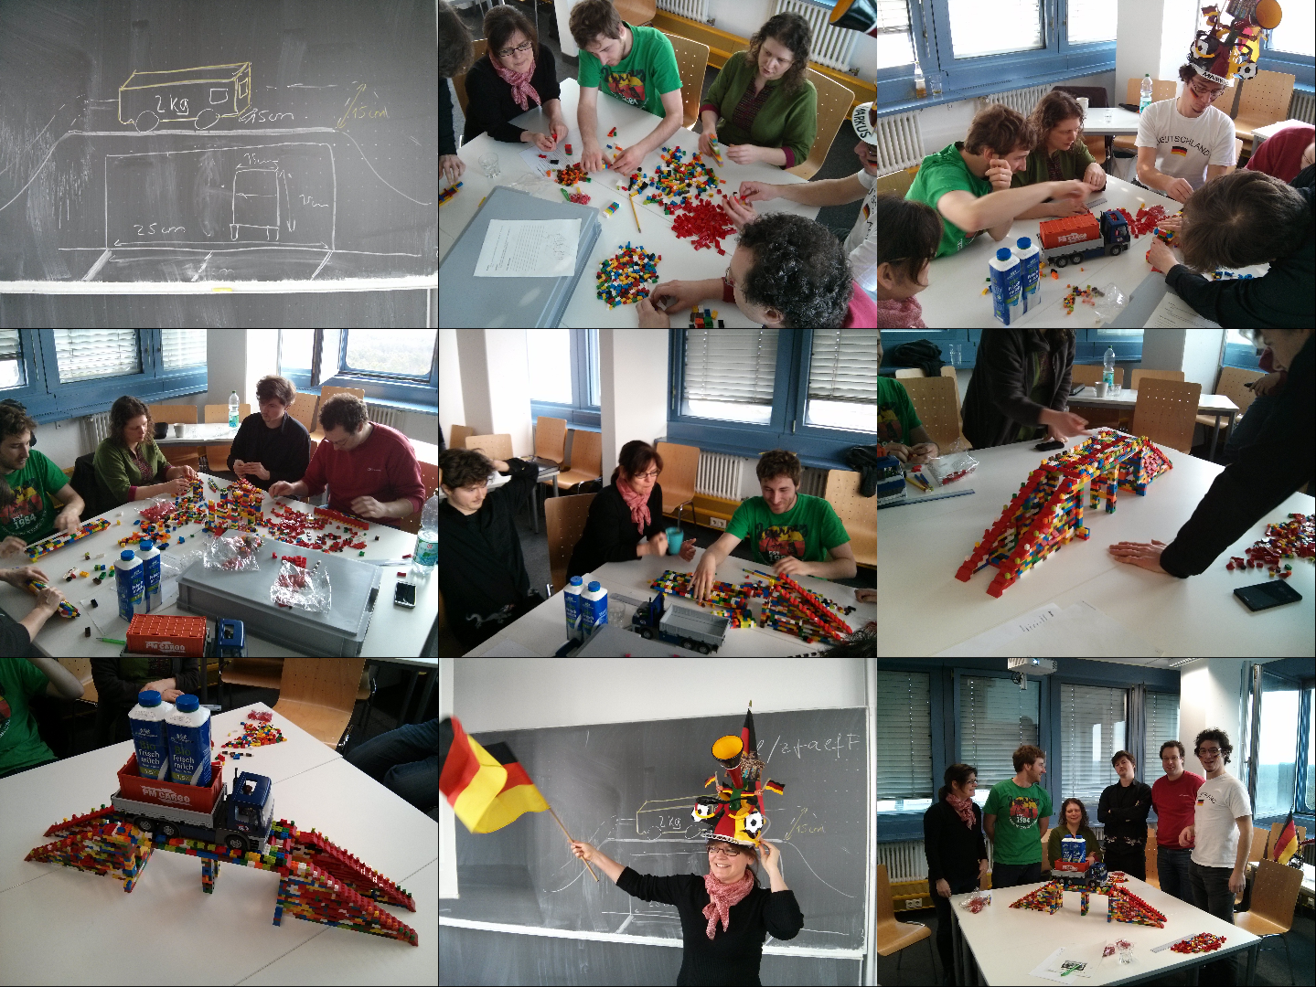
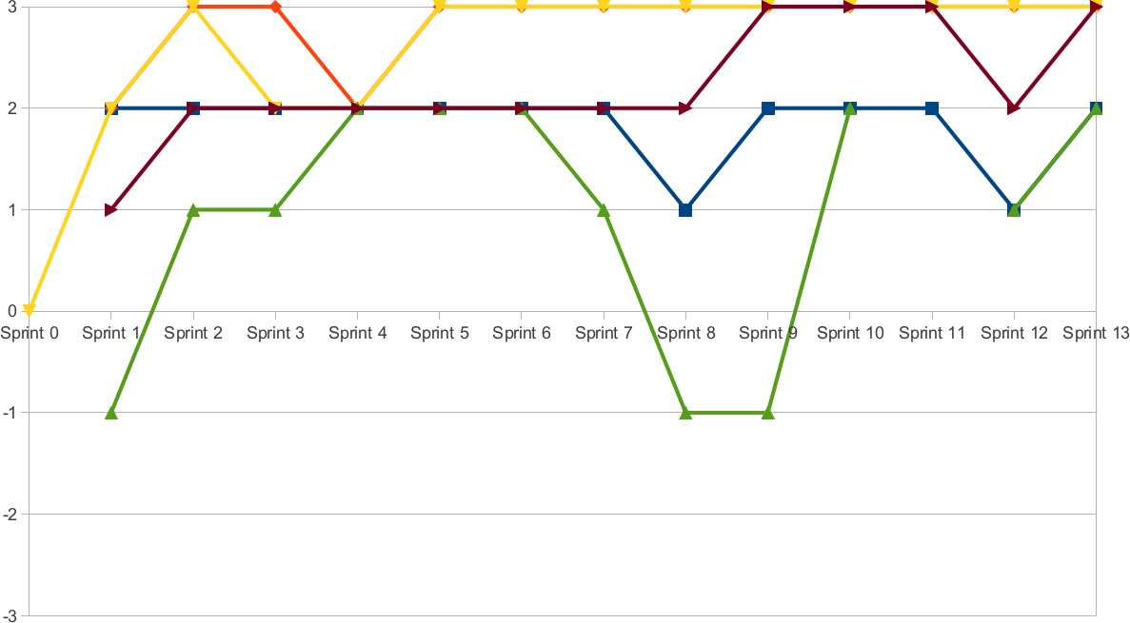
Project Coaching and Support

Slide 8
Demo Day Schedule
Time | Duration | Responsible | Title | Room
10:15 | 10 min | Riehle | Introduction | Main room
10:25 | 10 min | Teams | One slide summary | Main room
10:35 | 20 min | Teams | Demo | Demo rooms
10:55 | 20 min | Teams | Demo | Demo rooms
11:15 | 20 min | Teams | Demo | Demo rooms
11:35 | 5 min | Riehle | Conclusions | Main room

Slide 9
This Semester’s Projects
OpenSearch load tester with DATEV
Backup cluster manager with SEP
RTDIP time series forecasting with Shell
Robot visual perception with T-Systems

Slide 14
Let’s go see the demos!
Please join a breakout session [1]
[1] If you don’t see a choice window, please look to Breakout rooms in the menu bar or under More

Slide 15
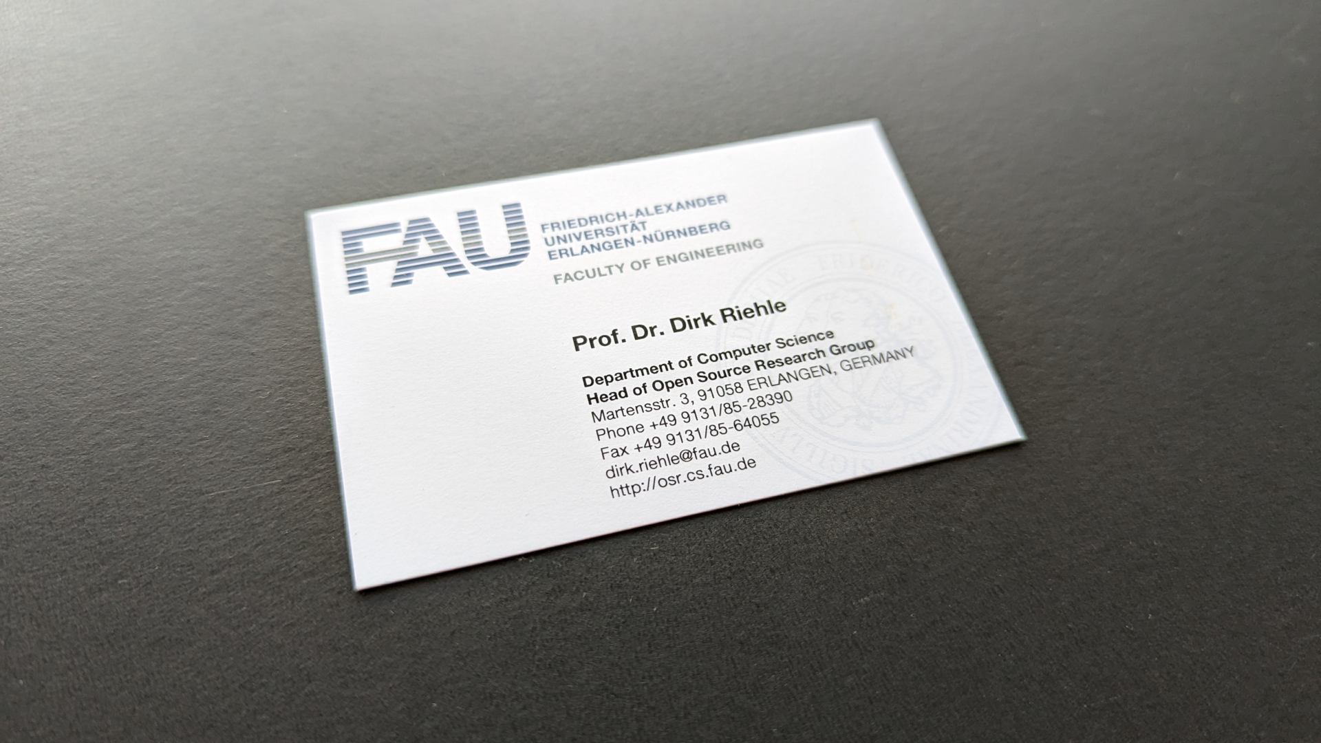

Slide 16
Thank you! Any questions?
dirk.riehle@fau.de – https://oss.cs.fau.de
dirk@riehle.org – https://dirkriehle.com – @dirkriehle

Slide 17
Legal Notices
License
Licensed under the CC BY 4.0 International license
Copyright
© Copyright 2009-2025 Dirk Riehle, some rights reserved

